Slide 1
IBM University Engagement Project Submission
“Exploring the Power of Agentic AI with IBM Granite and LangFlow”

Slide 2

Project Tile – [Shopping Agent]
Domain of Project – [ Shopping / fashion Industry ]
Student Name | Recent Passport Photo | Email ID | Mobile number [WhatsApp]
Om Dattatray More |  | ommore1006@gmail.com | 9975273756
Recommended font style and size: Font Style: Arial Font Size (Heading): 28
Font Size (Content): 20

Slide 3
Problem Statement -
Problem Statement : Intelligent Shopping Agent
The Challenge
Shoppers today face an overload of product options, scattered reviews, and dynamic pricing
across e-commerce platforms. Finding the right product that balances price, quality, and
personal preferences is time-consuming and frustrating. Traditional recommendation systems
often fail to capture real-time trends, personalized needs, or contextual factors like urgency,
budget, or sustainability. The challenge is not just to recommend products but to act as a smart
shopping companion that helps buyers make informed and confident decisions.
The Objective
Build an Agentic AI shopping assistant that provides intelligent, personalized, and real-time
support. The solution should :
1. Fuse Multisource Data: Aggregate product details, reviews, ratings, and price comparisons
across multiple e-commerce sites into unified insights.
2. Enable Multimodal Search: Allow users to input voice queries, images (e.g., a photo of a
product), or text descriptions to find best-matching products.
3. Create a Predictive & Agentic Layer: Suggest purchase timing (e.g., discounts, seasonal
offers), recommend alternatives, and alert users about price drops or fake reviews.
4. Visualize Smart Shopping Pulse: Provide a dashboard summarizing comparisons,
sustainability scores, trending products, and personalized shopping lists.

Slide 4
Proposed Solution -
Proposed Solution: AI-Powered Intelligent Shopping Agent
The proposed solution is a multi-agent AI-powered Intelligent Shopping Agent built using IBM LangFlow, IBM watsonx.ai, and IBM Granite Models to provide personalized, real-time shopping assistance. The system addresses the challenges of product discovery, price comparison, fake reviews, and purchase decision-making through an intelligent, modular architecture.
At its core, the solution uses a Retrieval-Augmented Generation (RAG) pipeline to retrieve product details, prices, customer reviews, ratings, and seller information from trusted e-commerce platforms. The retrieved data is embedded and stored in a vector database, enabling the system to provide accurate, up-to-date, and personalized shopping recommendations using IBM Granite models.
The system consists of five key agents:
1. Product Discovery Agent retrieves product details, specifications, availability, and ratings from multiple e-commerce platforms.
Price Comparison Agent compares prices across different online stores, analyzes historical price trends, and identifies the best available deals.
2 . Review Analysis Agent summarizes customer reviews, detects fake or misleading reviews, and generates a trust score for each product.
3 . Recommendation Agent provides personalized product recommendations based on user preferences such as budget, brand preference, usage, and previous shopping behavior.
4 . Shopping Dashboard Agent visualizes price comparisons, trending products, sustainability scores, personalized shopping lists, and price-drop alerts through an interactive dashboard.
5 . The solution supports multimodal search, allowing users to search products using text, voice, or product images for a more natural shopping experience.
LangFlow is used to orchestrate the workflows of multiple intelligent agents, while IBM watsonx.ai provides scalable model deployment, embeddings, and AI governance. IBM Granite models perform reasoning, product comparison, review summarization, and personalized recommendation generation.
Overall, the proposed solution delivers an end-to-end intelligent shopping assistant that simplifies online shopping through personalized insights, real-time price intelligence, trustworthy review analysis, and proactive buying recommendations.

Slide 5
Technology Used
Langflow platform -For designing and orchestrating multi-agent workflows visually.
IBM Granite model - for eg – ibm-granite-3-2-8b – For natural language understanding, reasoning, and personalization
IBM Cloud – Provides secure, scalable, and reliable infrastructure for deploying the Intelligent Shopping Agent.
RAG– Retrieves real-time product information before generating AI responses, improving accuracy and reliability.
IBM Watsonx.ai - For model deployment, embeddings, and AI governance
Vector Database (FAISS/Chroma) – For RAG-based nutritional data retrieval

Slide 6
Langflow component Used -
1) Chat Input – Allows users to search products through text, voice, or image input.
2) IBM watsonx AI Agent – Processes user requests using IBM Granite Models and coordinates multiple shopping agents.
3) IBM Granite Model
Granite-4.0-8B-Instruct – Generates personalized recommendations, summarizes reviews, compares products, and answers shopping queries.
4) Chat Output – Displays AI-generated recommendations, price comparisons, review summaries, and purchase suggestions.
5) File Component – Stores user preferences, shopping history, wish lists, and product datasets.
6) API Component – Connects with multiple e-commerce platforms to retrieve product information, pricing, and availability.
7) Vector Store Component – Stores embeddings for products, reviews, and specifications to enable RAG-based retrieval.

Slide 7
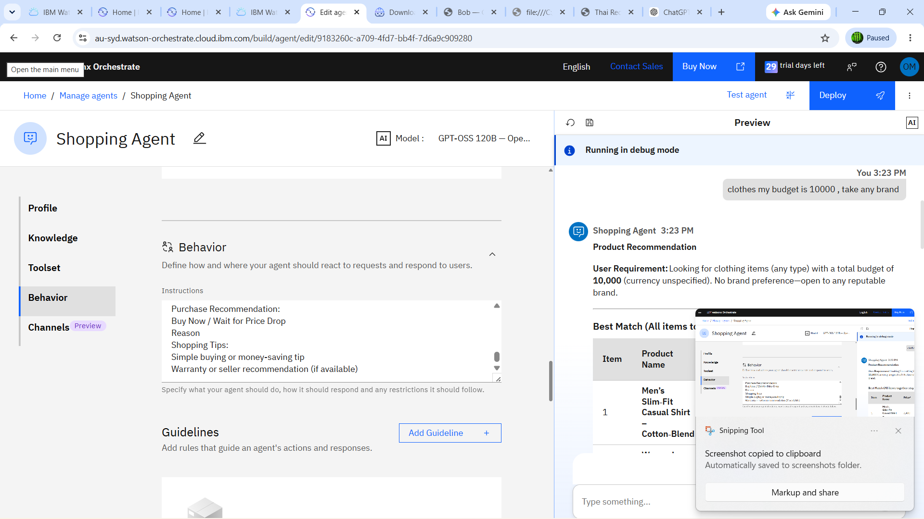
Lang flow :

Slide 8
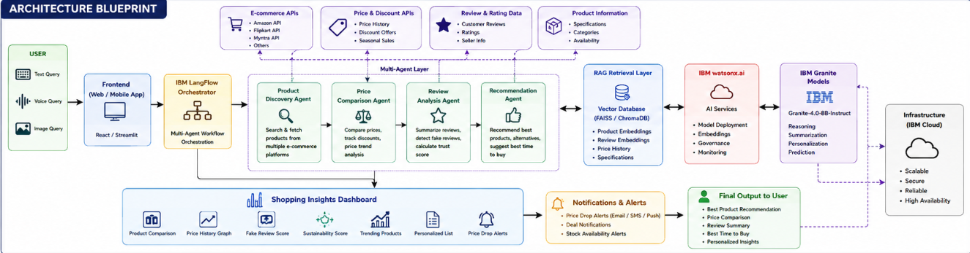

Slide 9

Role of Agentic AI in the solution
Role of Agentic AI in Intelligent Shopping Agent
Agentic AI enables the Intelligent Shopping Agent to function as an autonomous shopping companion rather than a traditional recommendation system. Using IBM watsonx.ai and IBM Granite models, it coordinates multiple specialized agents to assist users throughout the shopping journey.
Each agent performs a dedicated task—such as product discovery, price comparison, review analysis, recommendation generation, and dashboard visualization—while collaborating with other agents to provide accurate and context-aware shopping insights.
Agentic AI understands user preferences including budget, brand choices, urgency, shopping history, and sustainability preferences to generate personalized recommendations. It continuously monitors product prices, seasonal discounts, and availability to proactively notify users about the best time to purchase.
Additionally, the agents communicate with one another, enabling better decision-making, intelligent product comparison, and more reliable recommendations.
Overall, Agentic AI transforms the system into a proactive, personalized, and goal-driven shopping assistant that helps users make informed, confident, and cost-effective purchasing decisions.

Slide 10
Novelty and Uniqueness
The proposed Intelligent Shopping Agent stands out by combining Agentic AI, Retrieval-Augmented Generation (RAG), multimodal search, and predictive analytics into a single intelligent shopping platform.
Multi-Agent Intelligence – Multiple specialized AI agents collaborate to provide accurate, personalized, and context-aware shopping assistance.
RAG-Based Accuracy – Combines real-time product retrieval with AI-generated recommendations, reducing misinformation and improving trust.
Hyper-Personalization – Recommends products based on budget, preferences, shopping history, and lifestyle.
Predictive Purchase Timing – Analyzes historical price trends and seasonal sales to recommend the best time to buy.
Fake Review Detection – Uses AI to identify suspicious reviews and generate product trust scores.
Multi-Modal Search – Supports text, voice, and image-based product searches for improved accessibility.
Smart Shopping Dashboard – Visualizes product comparisons, sustainability scores, trending products, price alerts, and personalized shopping lists.

Slide 11
Git Hub Link
Please create public github repository (Enable Add README button while creating repository) with format –
Please test and Paste the working Github URL –
https://github.com/ommore06-coder/Shopping-Agent
·
·
·

Slide 12
Future Scope
1. Integration with Global E-Commerce Platforms
Expand support for platforms such as Amazon, Flipkart, Myntra, Ajio, Walmart, and eBay to provide broader product comparisons and better shopping options.
2. AI-Powered Voice Shopping & Multilingual Support
Enable voice-based shopping with multilingual capabilities, allowing users to search and purchase products naturally in their preferred language.
3. Augmented Reality (AR) Product Visualization
Allow users to virtually try products such as clothing, eyewear, furniture, and home décor before purchasing.
4. Autonomous Shopping Agent
Enable the AI assistant to automatically compare products, apply coupons, negotiate deals, place orders, and track deliveries on behalf of users.
·
·
·

Slide 13
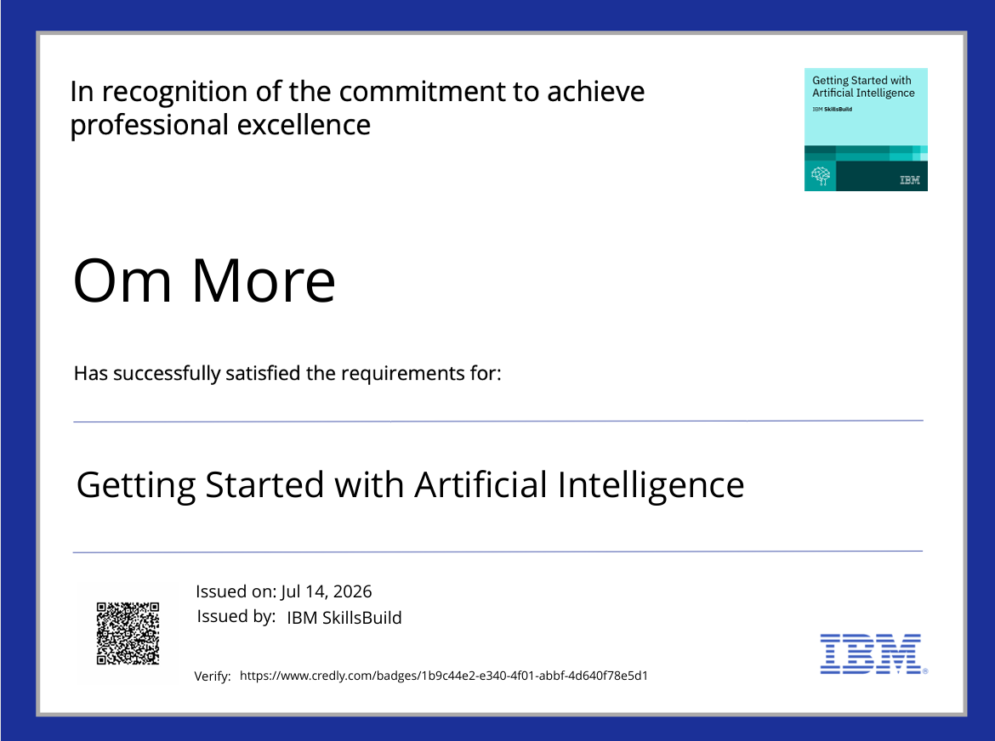
Certificates Earned:
Please add your credly certificate

Slide 14

Certificates Earned:​

Slide 15


